Slide 1
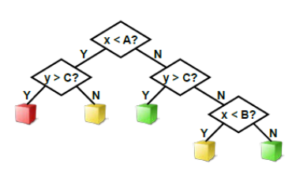
Decision Trees

Slide 2
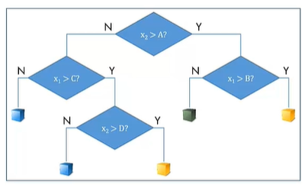
What is a Classification tree?
Binary decision trees classify observations by creating a sequence of yes/no questions
Given the training data, a decision tree is built by considering all the possible splits in each variable
Using a specific criterion for how good a potential split is, the best possible split is chosen
The process is repeated at different levels of the tree, until all the branches are determined:
Further splits do not improve the criterion value
Notes:
Introduction to Classification tree.

Slide 3
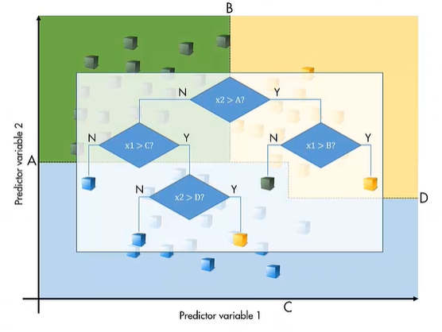
Prediction as a set of rules
The result is a classifier that divides the predictor space into a collection of rectangular regions
Making predictions is extremely quick, since it requires a sequences of handful binary decisions
A classification tree can be transformed in a set of decision rules:
the outcome is the leaf node
The path from the root of the tree to a leaf establishes conditions
The set of rules makes the classification tree easy to understand
Notes:
The prediction of a new observation consists in the application of the set of rules obtained from the classification tree

Slide 4
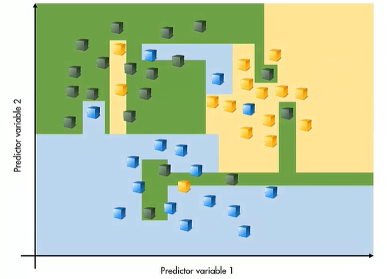
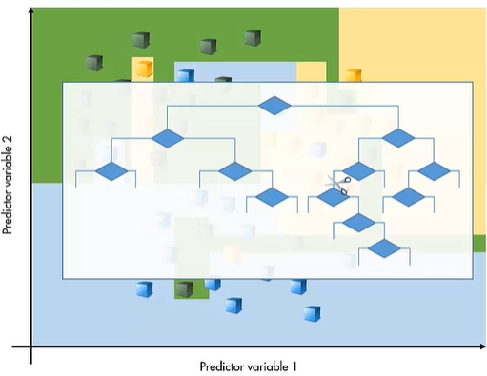
Pruning procedure
Realistic data may have noise
Theoretically, a complex tree could fit an arbitrarily complex boundary between points
However, this generally means that the model is overfitting the data
It is possible to prune a classification tree, that is, reduce the number of splits, to create a simpler model that may a higher re-substitution loss, but better generalization to new data
The re-substitution loss is the loss computed for the data that model used to create tree
Notes:
Pruning procedure can avoid overfitting problem

